Slide 1
Jermyn Borough Council Meeting
11/21/19

Slide 2
Meeting Agenda
Call to Order
Pledge of Allegiance
Roll Call
Special Awards
Previous Meeting Minutes
Treasurer’s Report/Bills Payable
Correspondence
Public Comment
Reports
Reports of Committees
L&I Solvency Fee
Feral Cat Ordinance
Parking on Madison Ave. Ordinance
Tree @ 705 Madison Ave
PA Small Water & Sewer Grant Resolution
2020 Budget Presentation
New Business
Adjournment

Slide 3
Treasurer’s report

Slide 4
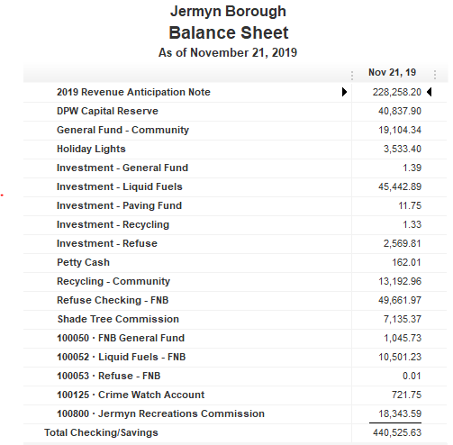

Slide 5
